Slide 1
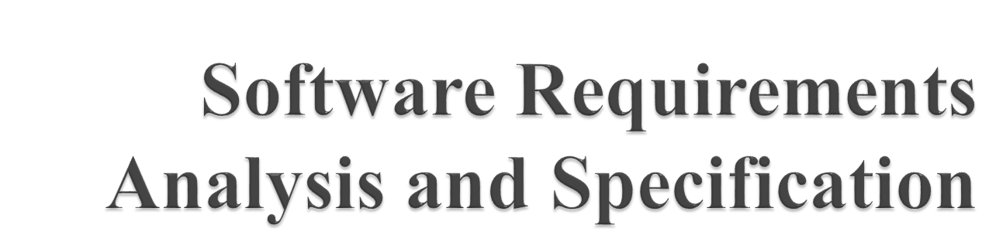

Slide 2

As per IEEE Standards:
A condition of capability needed by a user to solve a problem or achieve an objective;
A condition or a capability that must be met or possessed by a system….to satisfy a contract, standard, specification, or other formally imposed document.

Slide 3
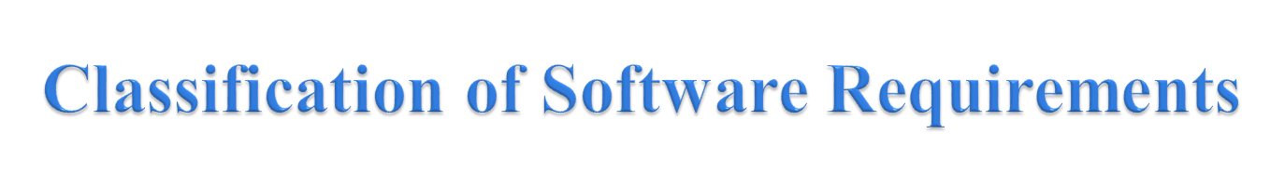
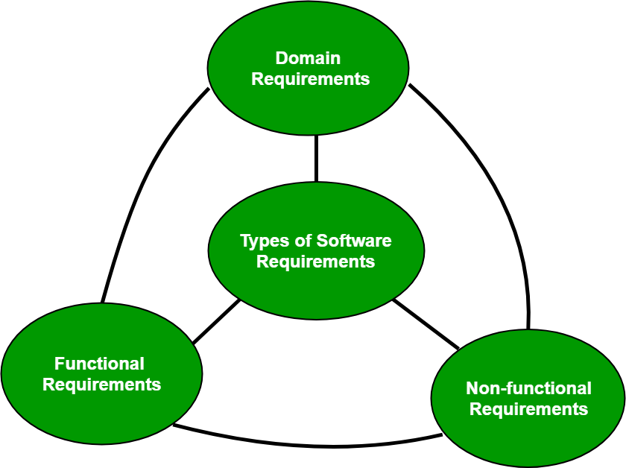
A software requirement can be of 3 types:
Functional requirements
Non-functional requirements
Domain requirements

Slide 4
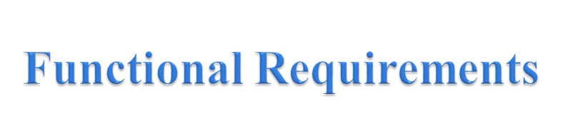
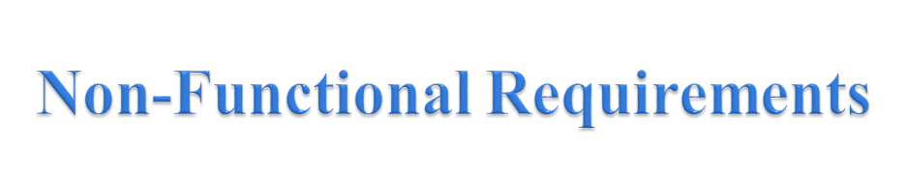
The requirements that the end user specifically demands as basic facilities that the system should offer. All these functionalities need to be necessarily incorporated into the system as a part of the contract.
These are basically the quality constraints that the system must satisfy according to the project contract. The priority or extent to which these factors are implemented varies from one project to other. They are also called non-behavioral requirements.

Slide 5
They basically deal with issues like:
    Portability
    Security
    Maintainability
    Reliability
    Scalability
    Performance
    Reusability
    Flexibility
NFR’s are classified into following types:
    Interface constraints
    Performance constraints: response time, security, storage space, etc.
    Operating constraints
    Life cycle constraints: maintainability, portability, etc.
    Economic constraints

Slide 6

Domain requirements are the requirements which are characteristic of a particular category or domain of projects. The basic functions that a system of a specific domain must necessarily exhibit come under this category.

Slide 7

A software requirements specification (SRS) is a description of a software system to be developed. It lays out functional and non-functional requirements, and may include a set of use cases that describe user interactions that the software must provide.

Slide 8

In order to fully understand one’s project, it is very important that they come up with a SRS listing out their requirements, how are they going to meet it and how will they complete the project.
It helps the team to save upon their time as they are able to comprehend how are going to go about the project. Doing this also enables the team to find out about the limitations and risks early on.

Slide 9

An SRS establishes the basis for agreement between the client and the supplier on what the software product will do.
An SRS provides a reference for validation of the final product.
A high-quality SRS is a pre-requisite to high-quality software.
A high-quality SRS reduces the development cost.

Slide 10

Requirement/Problem Analysis
Requirement Specification
Requirement Validation

Slide 11

Correct
Complete
Unambiguous
Verifiable
Consistent
Ranked for importance and/or stability

Slide 12

Functionality
Performance
Design constraints imposed on an implementation
External Interfaces

Slide 13

Actor: A person which uses the system being built for achieving some goal.
Primary Actor: The main actor for whom a use case is initiated and whose goal satisfaction is the main objective of the use case
Scenario: A set of actions that are performed to achieve a goal

Slide 14
4. Main success scenario: Describes the interaction if nothing fails and all steps in the scenario succeed.
5. Exceptional scenario: Describes the system behaviour if some of the steps in the main scenario do not complete successfully

